Slide 1
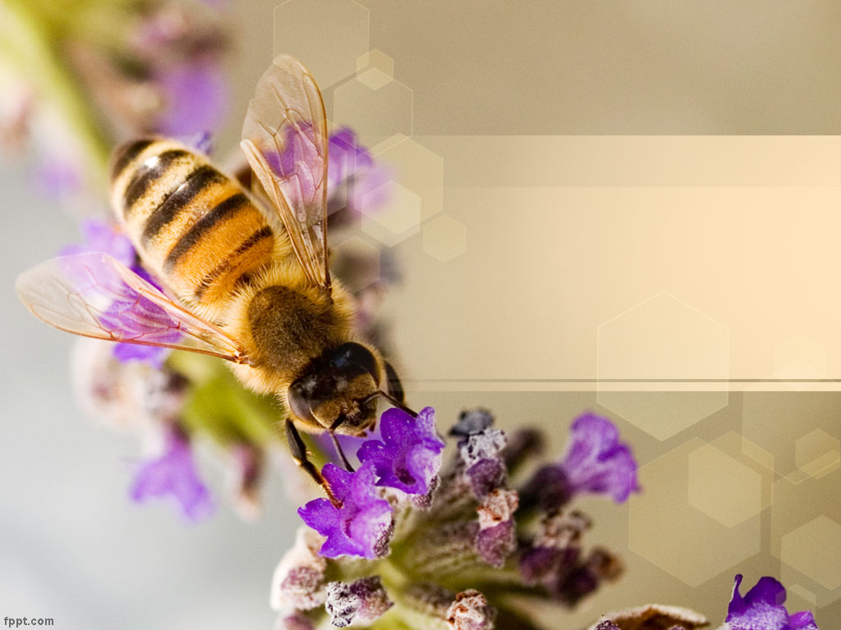
Buzz about the Bees Use of Data Analytics & Machine Learning to Improve Understanding of Honey Bee Colonies
Team: Richa Singh Drishti Yadav

Slide 2
Introduction
Pollination aided through honeybees is integral to crop production and has significant impact on global economy and food security .
value of global crops dependent on pollinators is in the range of US$235 to US$ 577 billion a year¹.
300 % increase in agricultural crop production dependency on pollinator since last 5 decades¹.
However, there has been noticeable decline in honeybee colonies and hive losses or Colony collapse disorder (CCD)
Studies have identified the following internal and external factors
harmful impact of pesticides,
Changes in land use and landscape structure, intensive agricultural practices, monocultures¹
mite infestations causing deformities in bees or robber bees that are not pollen bearing.
Climate Change
References
1. http://www.fao.org/3/I9527EN/i9527en.PDF
Notes:
Colony collapse disorder (CCD) is the phenomenon that occurs when the majority of worker bees in a colony disappear and leave behind a queen, plenty of food and a few nurse bees to care for the remaining immature bees.
As Per the Food and Agriculture Organization- It is estimated that the value of global crops dependent on pollinators is in the range of US$235 to US$ 577 billion a year. There has been a 300 percent increased in agricultural crop production dependency on pollinator since last 5 decades.
. pollination is the highest agricultural contributor to yields worldwide, contributing far beyond any other agricultural management practice. Thus, bees and other pollinators make important contributions to agriculture. Pollinators affect 35 percent of global agricultural land, supporting the production of 87. How important bees are can be ascertained from the fact that May 20th is observed as world Bee day. 3 out of 4 crops are in some way dependent pn polloinators of the leading food crops worldwide. Plus, pollination-dependent crops are five times more valuable than those that do not need pollination.

Slide 3
Project Overview
Key Questions –
What is the trend in number of colonies, total honey production, yield per colony
Analyze use of pesticides and its impact on number of colonies and yield
Using machine learning on bee images to distinguish between pollen carrying and non-pollen carrying bees to understand the population composition of bee colonies
Notes:
Sci-Kit Learn,
Keras (CNN)
Other analytical libraries include
Python Pandas,
Tableau
Matplotlib

Slide 4
Data
Data has been gathered from Kaggle –
https://www.kaggle.com/kevinzmith/honey-with-neonic-pesticide/home based on data derived from National Agricultural Statistics Service (NASS) and the United States Geological Survey (USGS)
https://www.kaggle.com/ivanfel/honey-bee-pollen- based on images derived from videos captured at the entrance of a bee colony in June 2017 at the Bee facility of the Gurabo Agricultural Experimental Station of the University of Puerto Rico¹
References
1. Ivan Rodriguez, Rémi Mégret, Edgar Acuña, José Agosto, Tugrul Giray. Recognition of pollen-bearing bees from Video using Convolutional Neural Network, IEEE Winter Conf. on Applications of Computer Vision, 2018, Lake Tahoe, NV. https://doi.org/10.1109/WACV.2018.00041

Slide 5
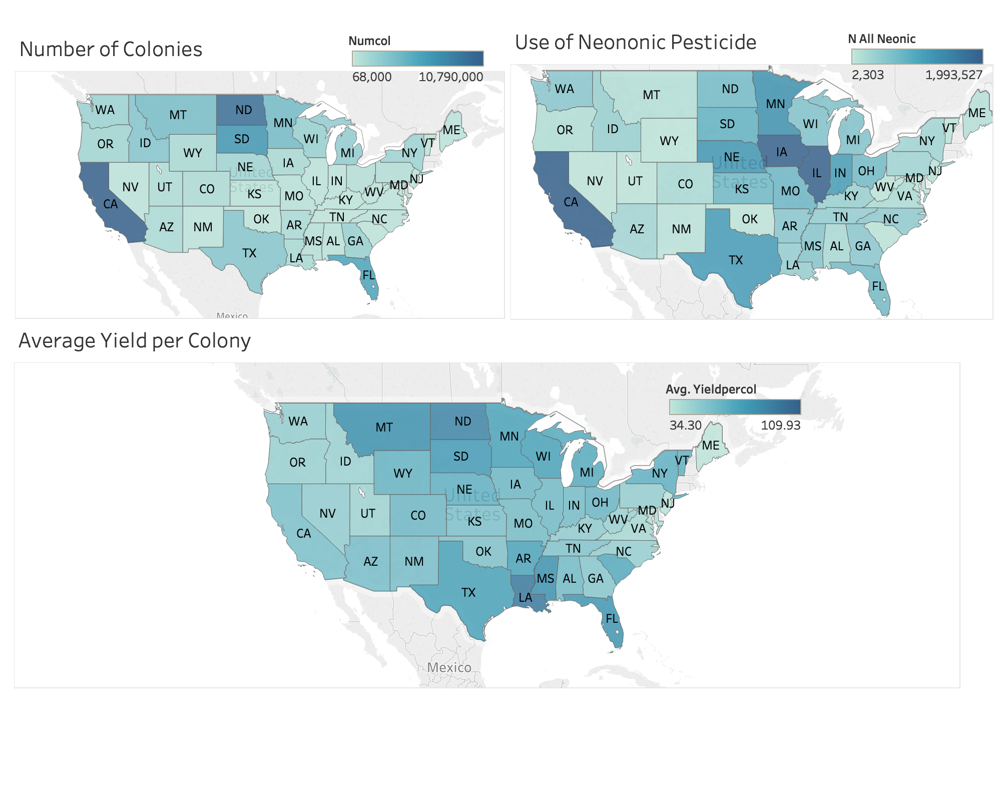
State-wise View of Number of Colonies, Use of Neonic Pesticides and Average Yield per Colony
Notes:
Year-wise data from 1992 to 2017, 1132 observations by state. 237 - had na… dropped those . 895 used for final analysis

Slide 6
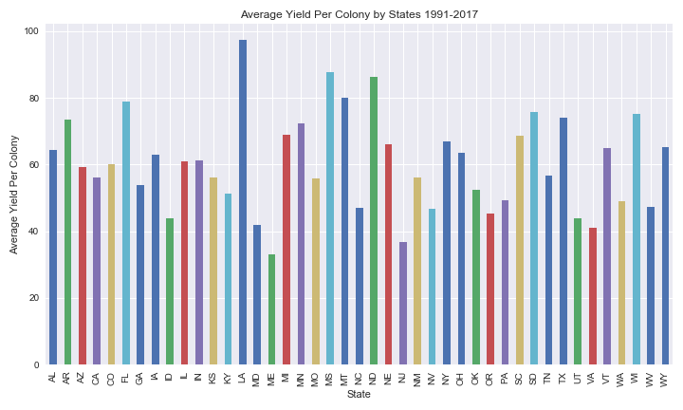
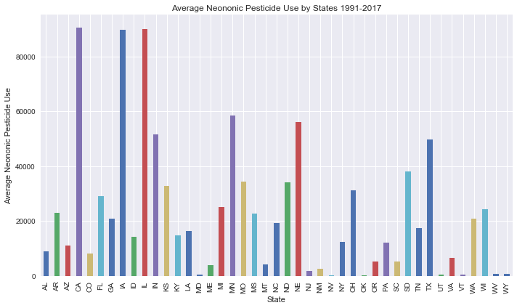
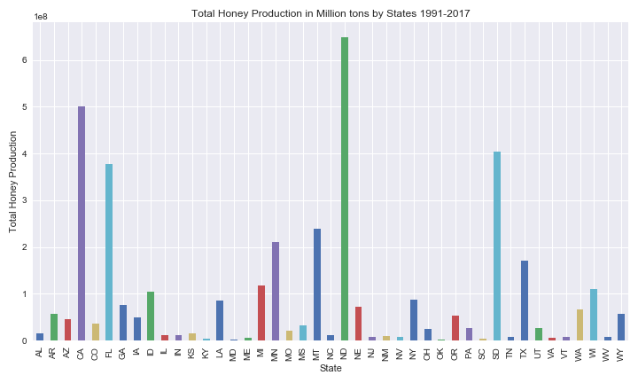
State-wise View of Number of Colonies, Use of Neonic Pesticides and Average Yield per Colony

Slide 7
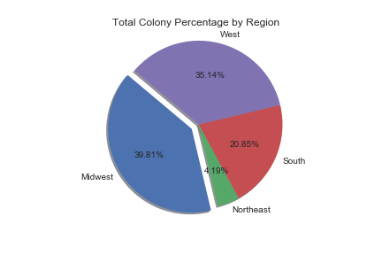
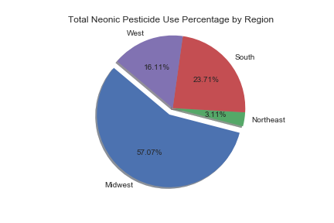
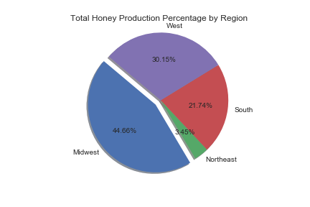
Region-wise Composition of Number of Colonies, Use of Neonic Pesticides and Average Yield per Colony

Slide 8
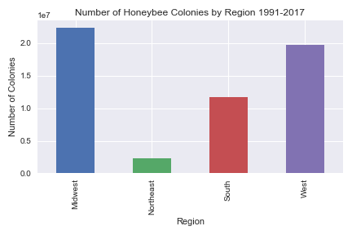
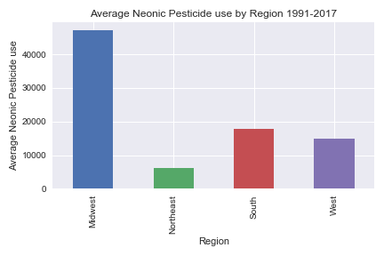
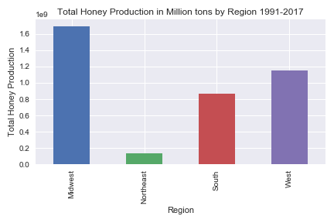
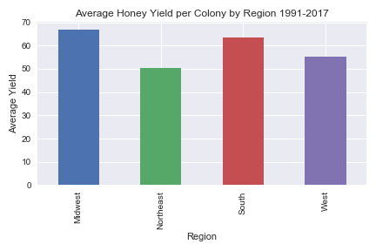
Region-wise Comparison of Number of Colonies, Use of Neonic Pesticides and Average Yield per Colony

Slide 9
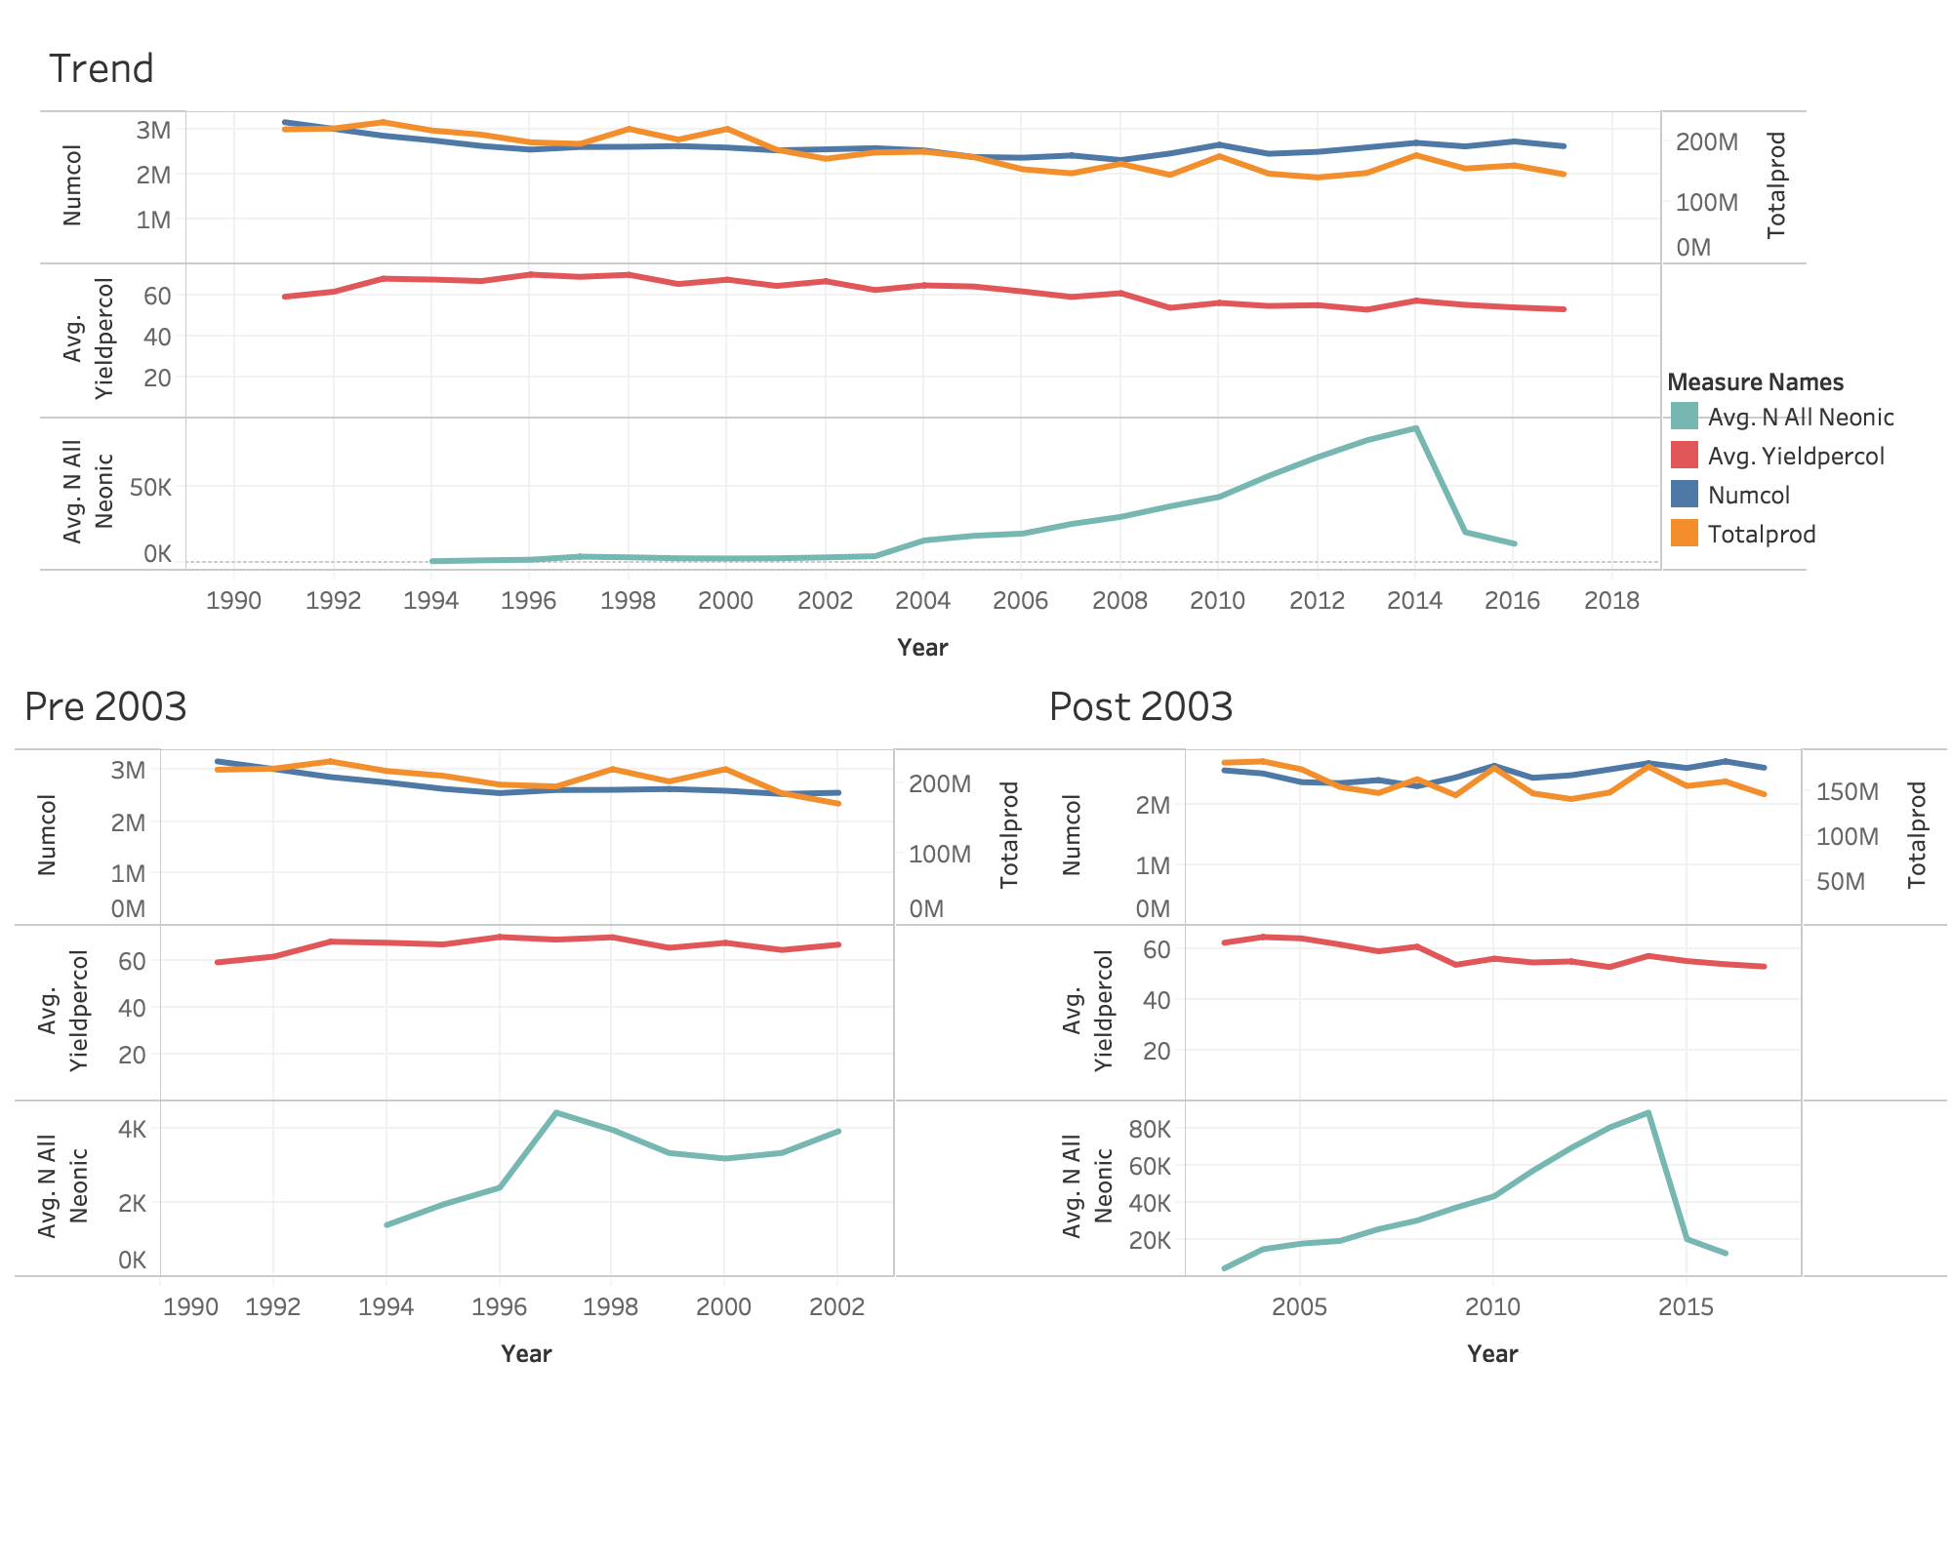
Trend in Number of Colonies, Use of Neonic Pesticides and Average Yield per Colony

Slide 10
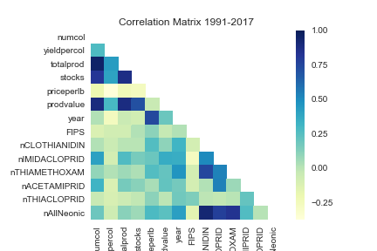
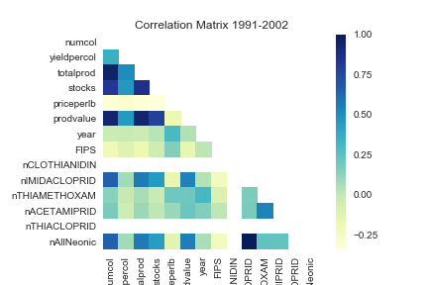
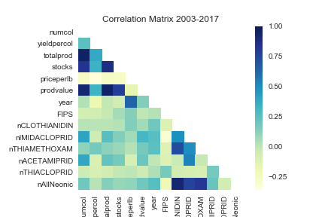
Correlation Analysis

Slide 11
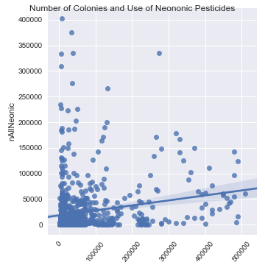
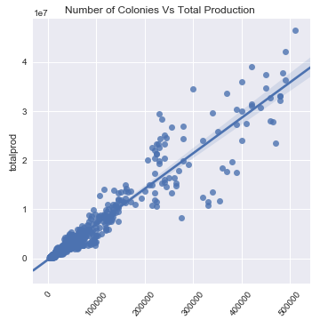
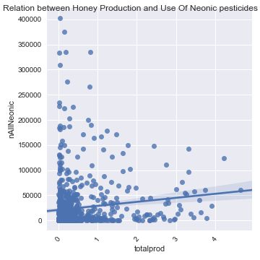
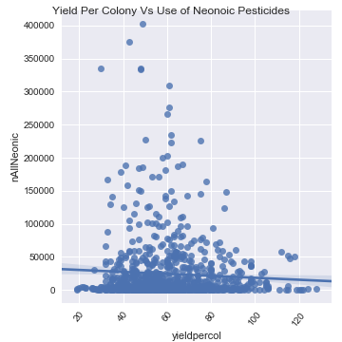
Relationship Analysis

Slide 12
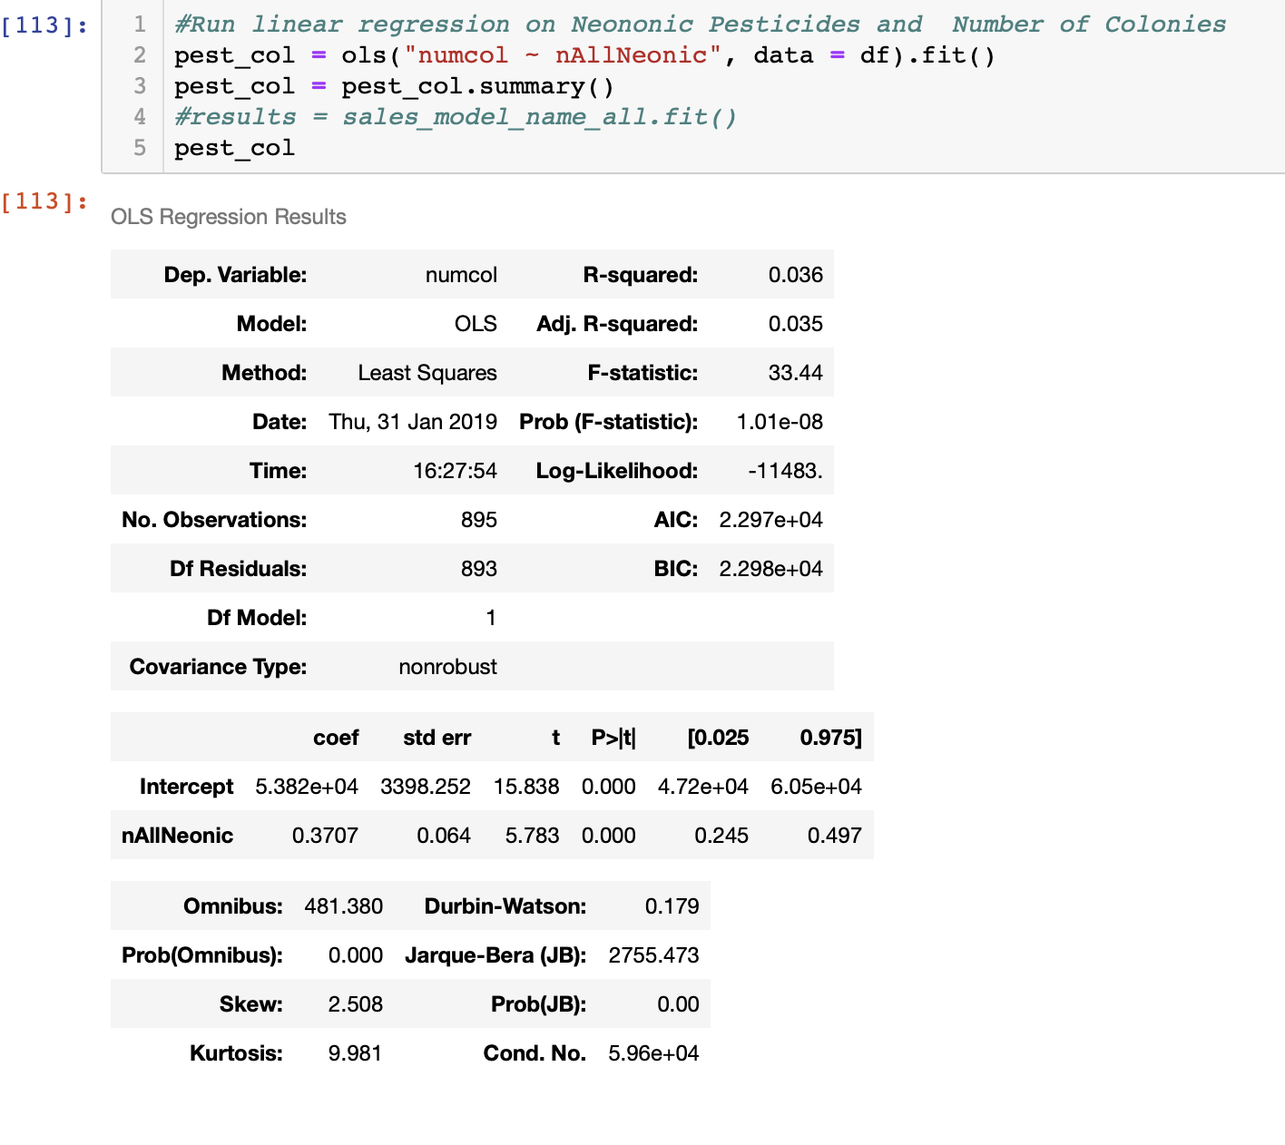
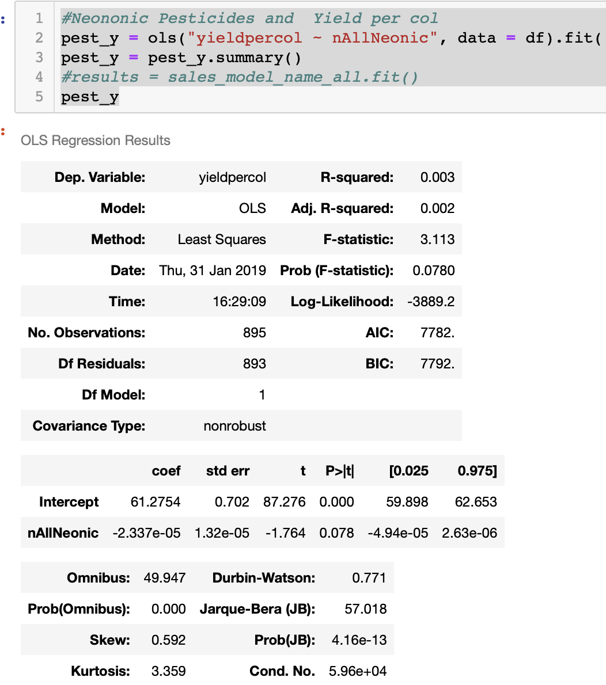
Linear Regression Analysis – all years

Slide 13
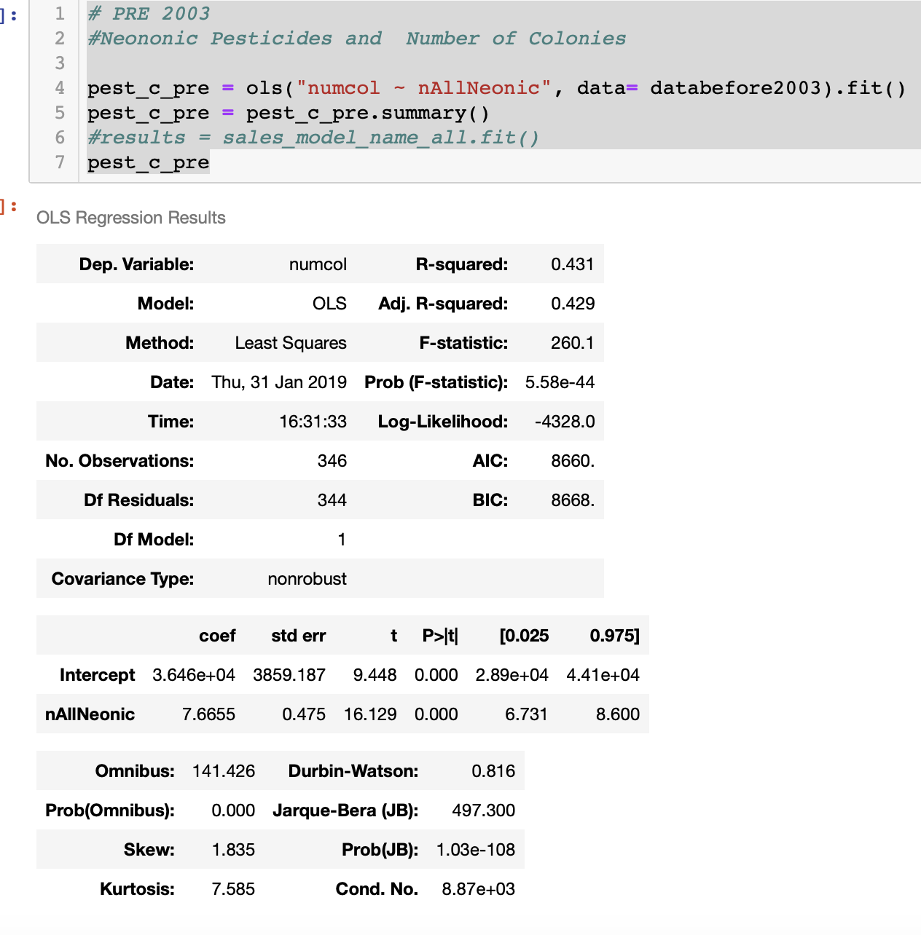
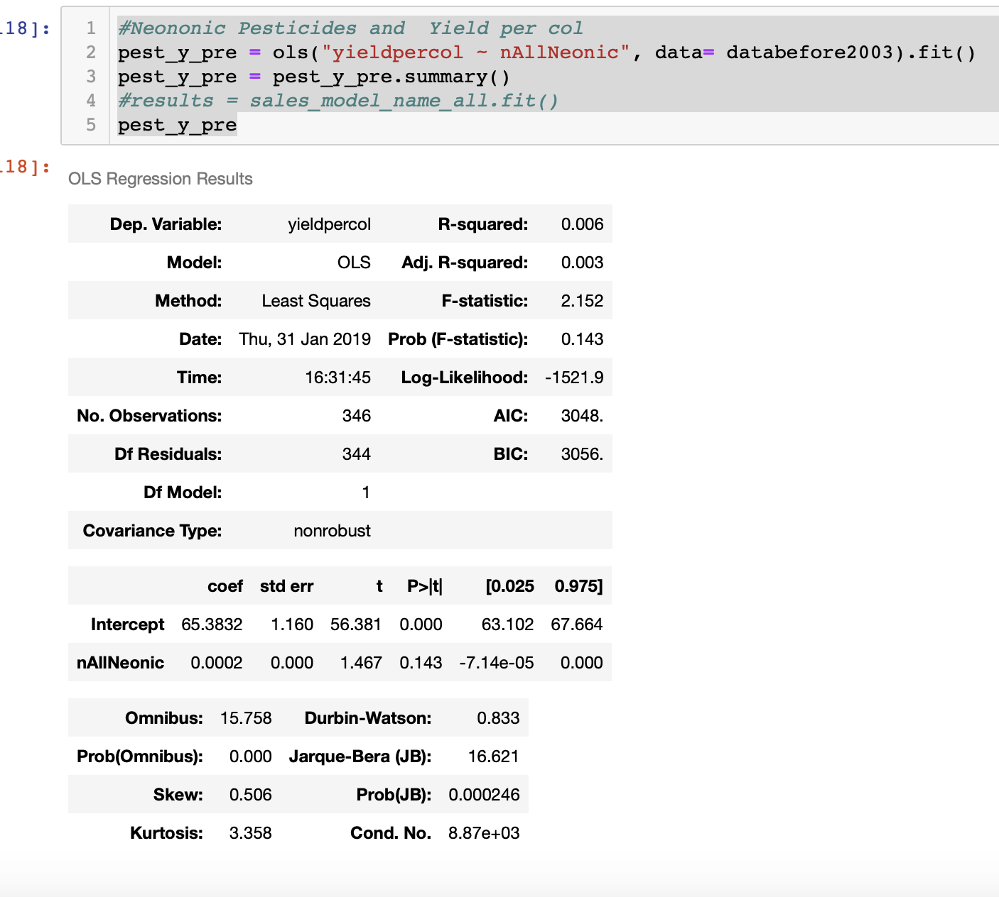
Linear Regression Analysis – Pre 2003

Slide 14
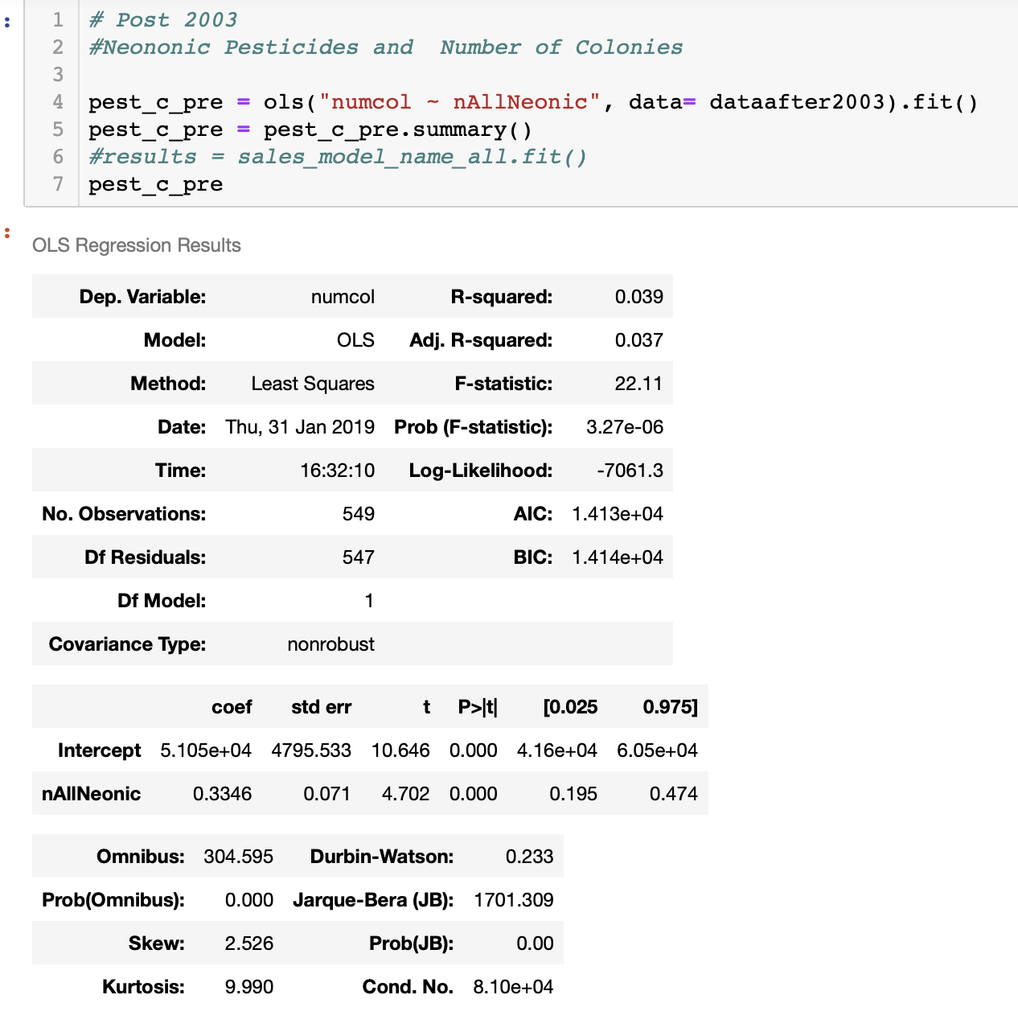
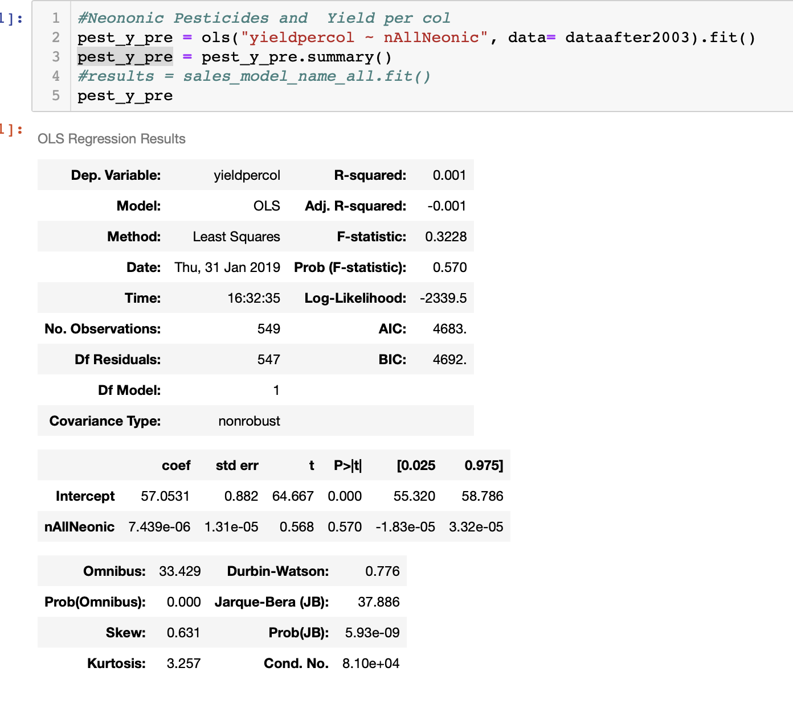
Linear Regression Analysis – Post 2003

Slide 15
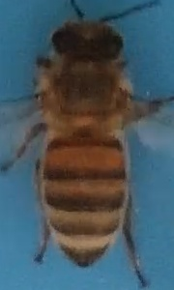
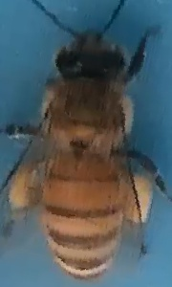
Machine Learning
Bee pollen is a ball of pollen made by young bees when they land on a flower. It’s a mixture of pollen, saliva, and nectar or honey. Bees carry these balls back to the hive in sacs on their legs and store them in the hive’s honeycomb.
Bee with no Pollen
Bee with Pollen

Slide 16
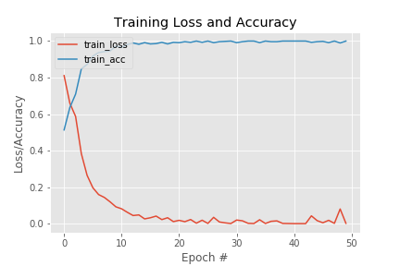
Machine Learning - CNN
Total 714 images of bees available – 369 pollen carrying and 345 non-pollen carrying
Custom CNN model trained on 80% data set and evaluated using the other 20%
Model Accuracy obtained: 95.1%

Slide 17
Questions

